Slide 1
Chapter 3 Transport Layer
TCP - Connection Management

Slide 2

Chapter 3: roadmap
Transport-layer services
Principles of reliable data transfer
Connection-oriented transport: TCP
segment structure
reliable data transfer
flow control
connection management
Principles of congestion control
TCP congestion control

Slide 3
TCP: overview RFCs: 793,1122, 2018, 5681, 7323
point-to-point:
one sender, one receiver
reliable, in-order byte steam:
no “message boundaries"
full duplex data:
bi-directional data flow in same connection
MSS: maximum segment size
cumulative ACKs
pipelining:
TCP congestion and flow control set window size
connection-oriented:
handshaking (exchange of control messages) initializes sender, receiver state before data exchange
flow controlled:
sender will not overwhelm receiver
Notes:
Typical MSS is 1460 bytes

Slide 4
TCP segment structure
32 bits
source port #
dest port #
segment seq #: counting bytes of data into bytestream (not segments!)
ACK: seq # of next expected byte; A bit: this is an ACK
sequence number
acknowledgement number
length (of TCP header)
head
len
not
used
A
P
S
receive window
flow control: # bytes receiver willing to accept
C
E
U
R
F
Internet checksum
checksum
Urg data pointer
options (variable length)
C, E: congestion notification
TCP options
application
data
(variable length)
data sent by application into TCP socket
RST, SYN, FIN: connection management

Slide 5
TCP sequence numbers, ACKs
outgoing segment from sender
Sequence numbers:
byte stream “number” of first byte in segment’s data
source port #
dest port #
sequence number
acknowledgement number
rwnd
checksum
urg pointer
window size
N
Acknowledgements:
seq # of next byte expected from other side
cumulative ACK
sender sequence number space
sent
ACKed
sent, not-yet ACKed
(“in-flight”)
usable
but not
yet sent
not
usable
Q: how receiver handles out-of-order segments
A: TCP spec doesn’t say, - up to implementor
outgoing segment from receiver
source port #
dest port #
sequence number
acknowledgement number
A
rwnd
checksum
urg pointer

Slide 6

TCP sequence numbers, ACKs
Host A
Host B
User types‘C’
Seq=42, ACK=79, data = ‘C’
host ACKs receipt of‘C’, echoes back ‘C’
Seq=79, ACK=43, data = ‘C’
host ACKs receipt of echoed ‘C’
Seq=43, ACK=80
simple telnet scenario
Notes:
The key thing to note here is that the ACK number (43) on the B-to-A segment is one more than the sequence number (42) on the A-to-B segment that triggered that ACK
Similarly, the ACK number (80) on the last A-to-B segment is one more than the sequence number (79) on the B-to-A segment that triggered that ACK

Slide 7
TCP Receiver: ACK generation [RFC 5681]
Event at receiver
arrival of in-order segment with
expected seq #. All data up to
expected seq # already ACKed
arrival of in-order segment with
expected seq #. One other
segment has ACK pending
arrival of out-of-order segment
higher-than-expect seq. # .
Gap detected
arrival of segment that
partially or completely fills gap
TCP receiver action
delayed ACK. Wait up to 500ms
for next segment. If no next segment,
send ACK
immediately send single cumulative
ACK, ACKing both in-order segments
immediately send duplicate ACK,
indicating seq. # of next expected byte
immediate send ACK, provided that
segment starts at lower end of gap
Notes:
Rather than immediately Acknowledging this segment, many TCP implementations will wait for half a second for another in-order segment to arrive, and then generate a single cumulative ACK for both segments – thus decreasing the amount of ACK traffic. The arrival of this second in-order segment and the cumulative ACK generation that covers both segments is the second row in this table.

Slide 8
TCP: retransmission scenarios
Host A
Host B
Host A
Host B
SendBase=92
Seq=92, 8 bytes of data
Seq=92, 8 bytes of data
timeout
timeout
Seq=100, 20 bytes of data
ACK=100
X
ACK=100
ACK=120
Seq=92, 8 bytes of data
Seq=92, 8
bytes of data
SendBase=100
send cumulative
ACK for 120
SendBase=120
ACK=100
ACK=120
SendBase=120
lost ACK scenario
premature timeout
Notes:
To cement our understanding of TCP reliability, let’s look a a few retransmission scenarios
In the first case a TCP segments is transmitted and the ACK is lost, and the TCP timeout mechanism results in another copy of being transmitted and then re-ACKed a the sender
In the second example two segments are sent and acknowledged, but there is a premature timeout e for the first segment, which is retransmitted. Note that when this retransmitted segment is received, the receiver has already received the first two segments, and so resends a cumulative ACK for both segments received so far, rather than an ACK for just this fist segment.

Slide 9
TCP: retransmission scenarios
Host A
Host B
Seq=92, 8 bytes of data
Seq=100, 20 bytes of data
ACK=100
X
ACK=120
Seq=120, 15 bytes of data
cumulative ACK covers for earlier lost ACK
Notes:
And in this last example, two segments are again transmitted, the first ACK is lost but the second ACK, a cumulative ACK arrives at the sender, which then can transmit a third segment, knowing that the first two have arrived, even though the ACK for the first segment was lost

Slide 10


Agreeing to establish a connection
2-way handshake:
Q: will 2-way handshake always work in network?
variable delays
retransmitted messages (e.g. req_conn(x)) due to message loss
message reordering
can’t “see” other side
Let’s talk
ESTAB
OK
ESTAB
choose x
req_conn(x)
ESTAB
acc_conn(x)
ESTAB
Notes:
Here’s an example of a two way handshake. Alice reaches out to Bob and say’s “let’s talk” and Bob says OK, and they start their conversation
For a network protocol, the equivalent protocol would be a client sending a “request connection” message saying ”let’s talk, the initial sequence number is x”
And the server would respond with a message ”I accept your connect x”
And the question we want to ask ourselves is <talk through>
Will this work? Let’s look at a few scenarios…

Slide 11

2-way handshake scenarios
choose x
req_conn(x)
ESTAB
acc_conn(x)
ESTAB
data(x+1)
accept
data(x+1)
ACK(x+1)
connection
x completes
No problem!

Slide 12

2-way handshake scenarios
choose x
req_conn(x)
ESTAB
retransmit
req_conn(x)
acc_conn(x)
ESTAB
req_conn(x)
connection
x completes
client terminates
server
forgets x
ESTAB
acc_conn(x)
Problem: half open connection! (no client)

Slide 13
2-way handshake scenarios
choose x
req_conn(x)
ESTAB
retransmit
req_conn(x)
acc_conn(x)
ESTAB
data(x+1)
accept
data(x+1)
retransmit
data(x+1)
connection
x completes
client terminates
server
forgets x
req_conn(x)
ESTAB
data(x+1)
accept
data(x+1)
Problem: dup data
accepted!

Slide 14
TCP 3-way handshake
Server state
Client state
serverSocket = socket(AF_INET,SOCK_STREAM)
serverSocket.bind((‘’,serverPort))
serverSocket.listen(1)
connectionSocket, addr = serverSocket.accept()
clientSocket = socket(AF_INET, SOCK_STREAM)
LISTEN
clientSocket.connect((serverName,serverPort))
LISTEN
choose init seq num, x
send TCP SYN msg
SYNSENT
SYNbit=1, Seq=x
choose init seq num, y
send TCP SYNACK
msg, acking SYN
SYN RCVD
SYNbit=1, Seq=y
ACKbit=1; ACKnum=x+1
received SYNACK(x)
indicates server is live;
send ACK for SYNACK;
this segment may contain
client-to-server data
ESTAB
ACKbit=1, ACKnum=y+1
received ACK(y)
indicates client is live
ESTAB
Notes:
TCP’s three way handshake, that operates as follows
Let’s say the client and server both create a TCP socket as we learned about in Chapter 2 and enter the LISTEN state
The client then connects to the server sending a SYN message with a sequence number x (SYN Message is an TCP Segment with SYN but set in the header – you might want to go back and review the TCP segment format!)
The server is waiting for a connection, and receives the SYN message enters the SYN received state (NOT the established state and sends a SYN ACK message back.
Finally the client sends an ACK message to the server, and when the server receiver this enters the Established state. This is when the application process would see the return from the wait on the socket accept() call

Slide 15
Closing a TCP connection
client, server each close their side of connection
send TCP segment with FIN bit = 1
respond to received FIN with ACK
on receiving FIN, ACK can be combined with own FIN
simultaneous FIN exchanges can be handled
Notes:
All good things must come to an end, and that’s true for a TCP connection as well.
And of course there’s a protocol for one side to gracefully close of a TCP connection using a FIN message, to which the other side sends a FINACK message and waits around a bit to respond to any retransmitted FIN messages before timing out.

Slide 16
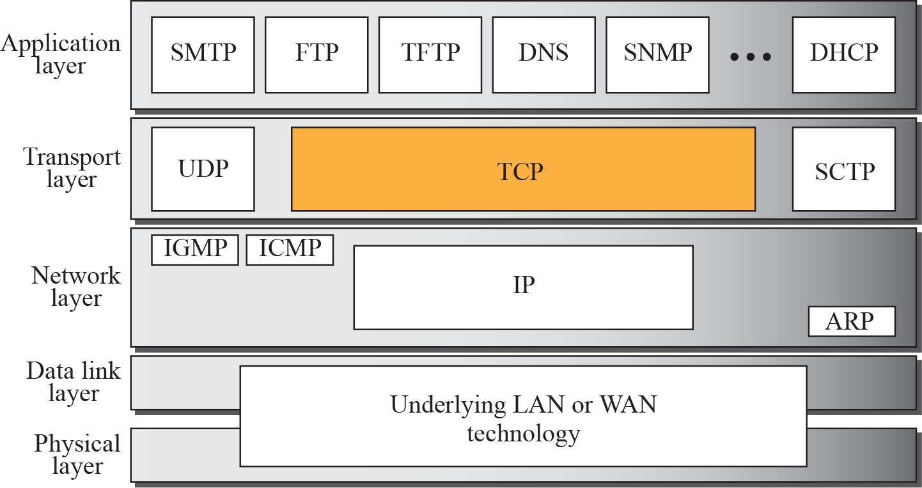
Figure 15.1 TCP/IP protocol suite
TCP/IP Protocol Suite
‹#›
Notes:
‹#›

Slide 17
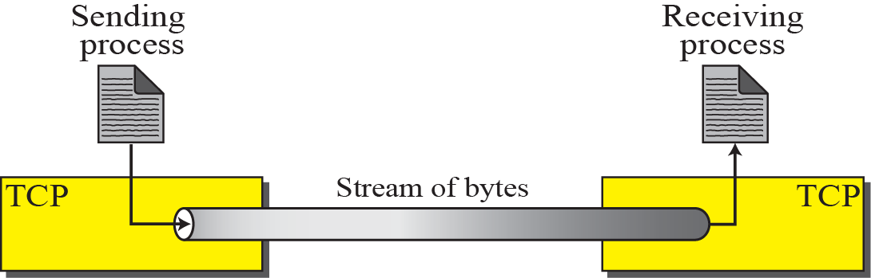
Figure 15.2 Stream delivery
TCP/IP Protocol Suite
‹#›
Notes:
‹#›

Slide 18
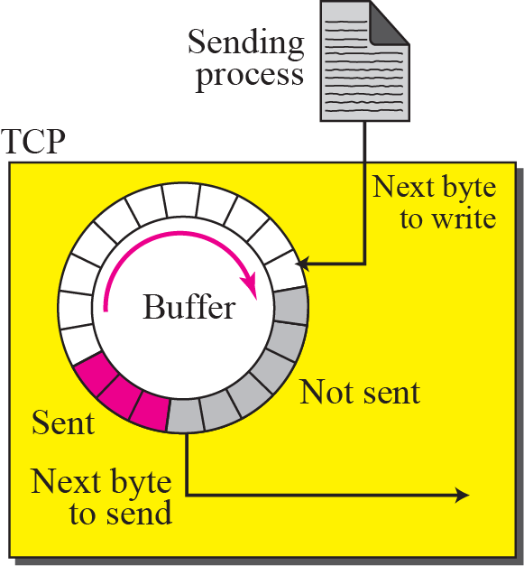
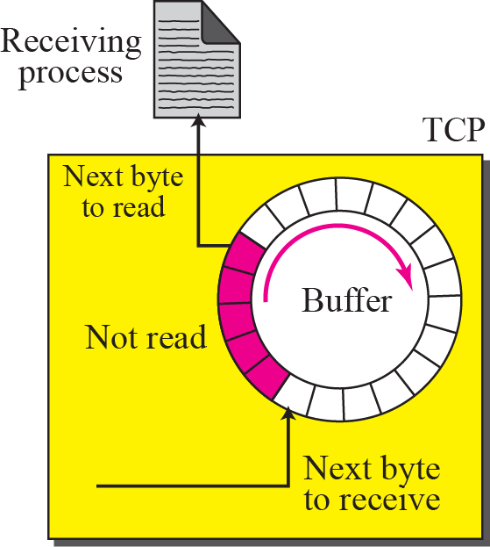
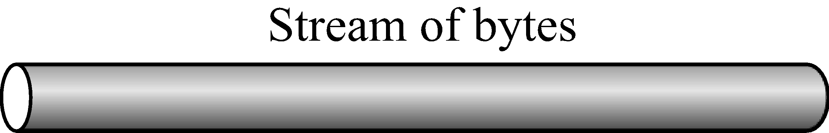
Figure 15.3 Sending and receiving buffers
TCP/IP Protocol Suite
‹#›
Notes:
‹#›

Slide 19
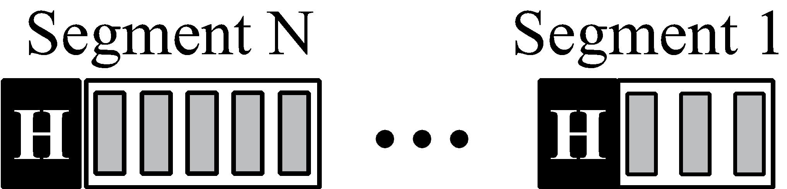
Figure 15.4 TCP segments
TCP/IP Protocol Suite
‹#›
Notes:
‹#›

Slide 20
Topics Discussed in the Section
Numbering System
Flow Control
Error Control
Congestion Control
TCP/IP Protocol Suite
‹#›
Notes:
‹#›

Slide 21

Note
The bytes of data being transferred in each connection are numbered by TCP.
The numbering starts with an arbitrarily generated number.
TCP/IP Protocol Suite
‹#›
Notes:
‹#›

Slide 22
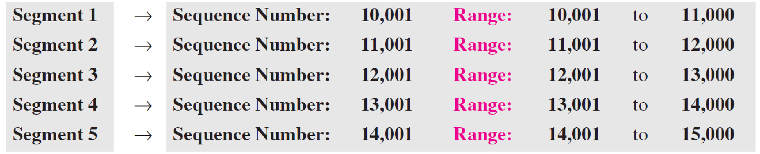
Example 15.1
Suppose a TCP connection is transferring a file of 5,000 bytes. The first byte is numbered 10,001. What are the sequence numbers for each segment if data are sent in five segments, each carrying 1,000 bytes?
Solution
The following shows the sequence number for each segment:
TCP/IP Protocol Suite
‹#›
Notes:
‹#›

Slide 23
Note
The value in the sequence number field of a segment defines the number assigned to the first data byte contained in that segment.
TCP/IP Protocol Suite
‹#›
Notes:
‹#›

Slide 24
Note
The value of the acknowledgment field in a segment defines the number of the next byte a party expects to receive.
The acknowledgment number is cumulative.
TCP/IP Protocol Suite
‹#›
Notes:
‹#›

Slide 25
15-3 SEGMENT
Before discussing TCP in more detail, let us discuss the TCP packets themselves. A packet in TCP is called a segment.
TCP/IP Protocol Suite
‹#›
Notes:
‹#›

Slide 26
Topics Discussed in the Section
Format
Encapsulation
TCP/IP Protocol Suite
‹#›
Notes:
‹#›

Slide 27
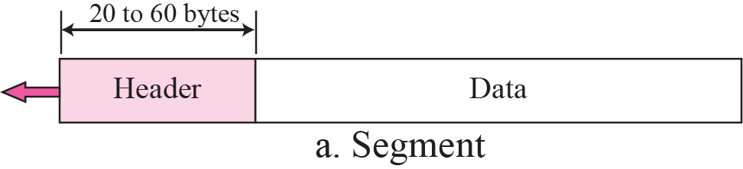
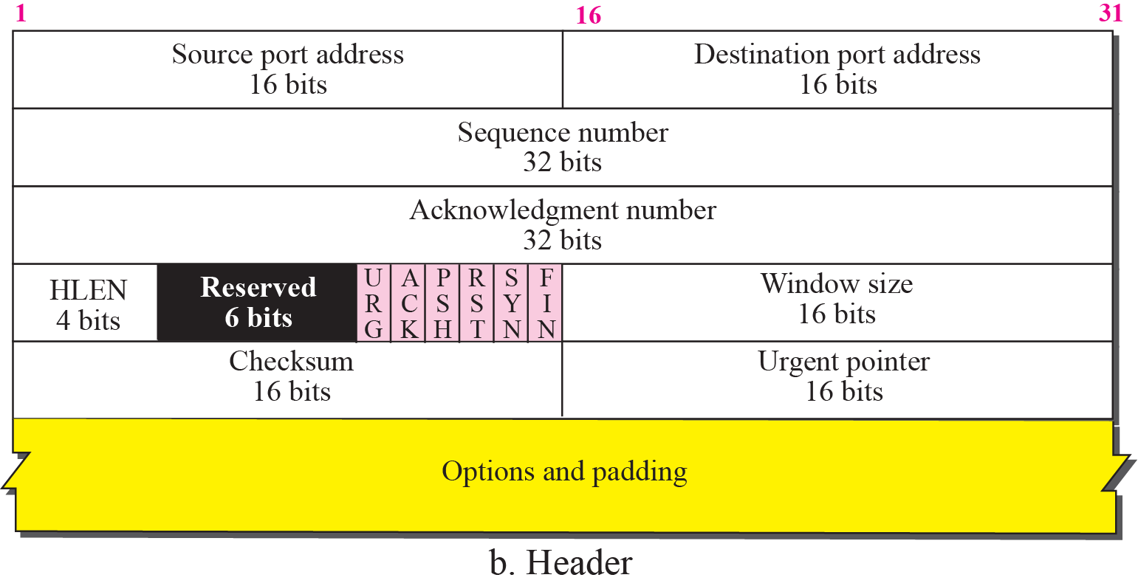
Figure 15.5 TCP segment format
TCP/IP Protocol Suite
‹#›
Notes:
‹#›

Slide 28
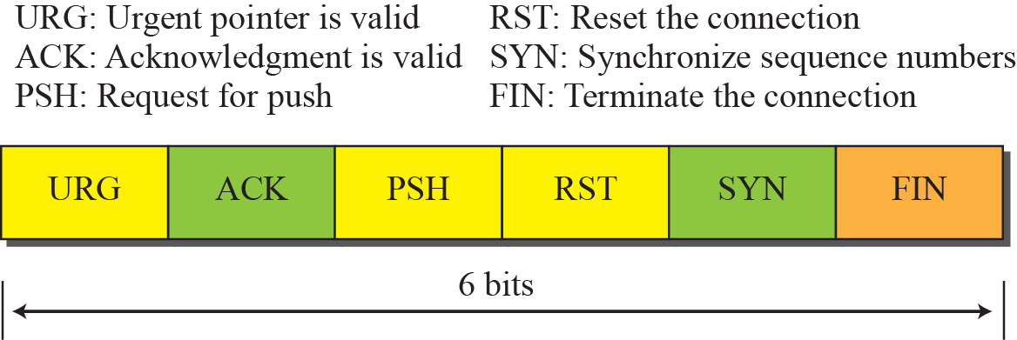
Figure 15.6 Control field
TCP/IP Protocol Suite
‹#›
Notes:
‹#›

Slide 29
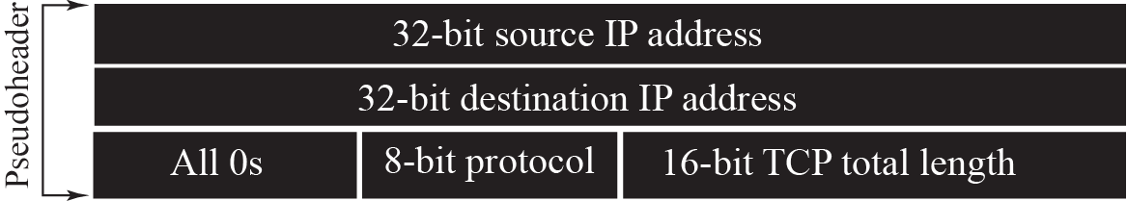
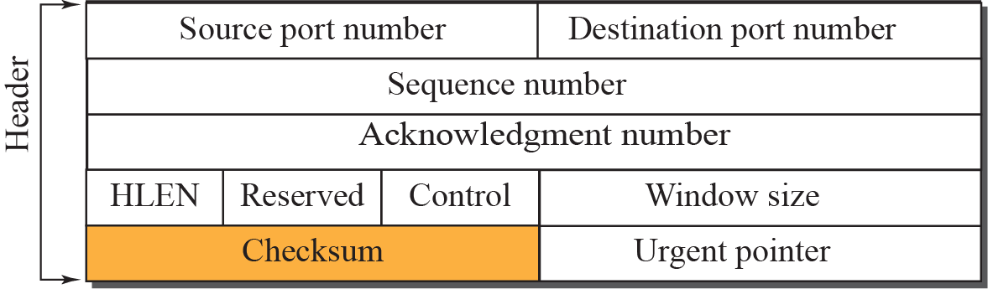

Figure 15.7 Pseudoheader added to the TCP segment
TCP/IP Protocol Suite
‹#›
Notes:
‹#›

Slide 30
Note
The use of the checksum in TCP is mandatory.
TCP/IP Protocol Suite
‹#›
Notes:
‹#›

Slide 31



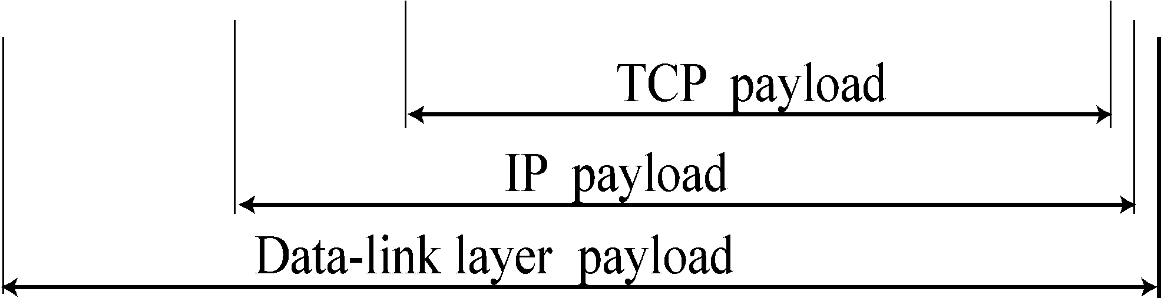
Figure 15.8 Encapsulation
TCP/IP Protocol Suite
‹#›
Notes:
‹#›

Slide 32
Topics Discussed in the Section
Connection Establishment
Data Transfer
Connection Termination
Connection Reset
TCP/IP Protocol Suite
‹#›
Notes:
‹#›

Slide 33
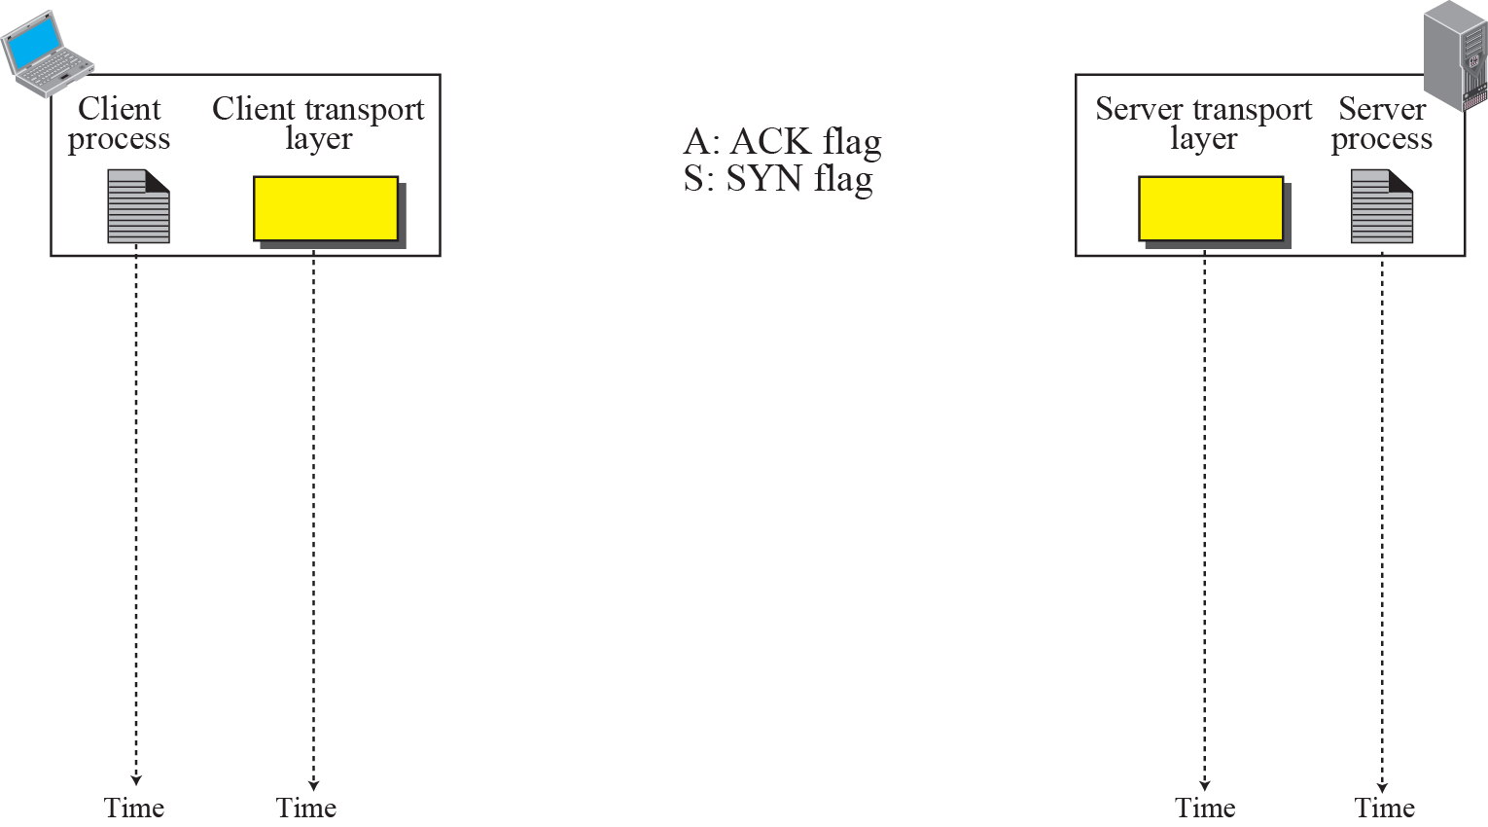


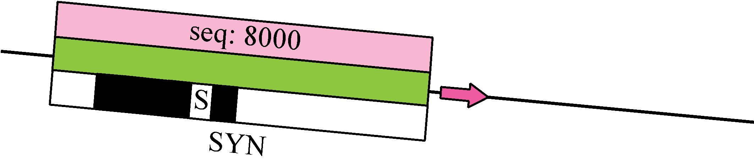
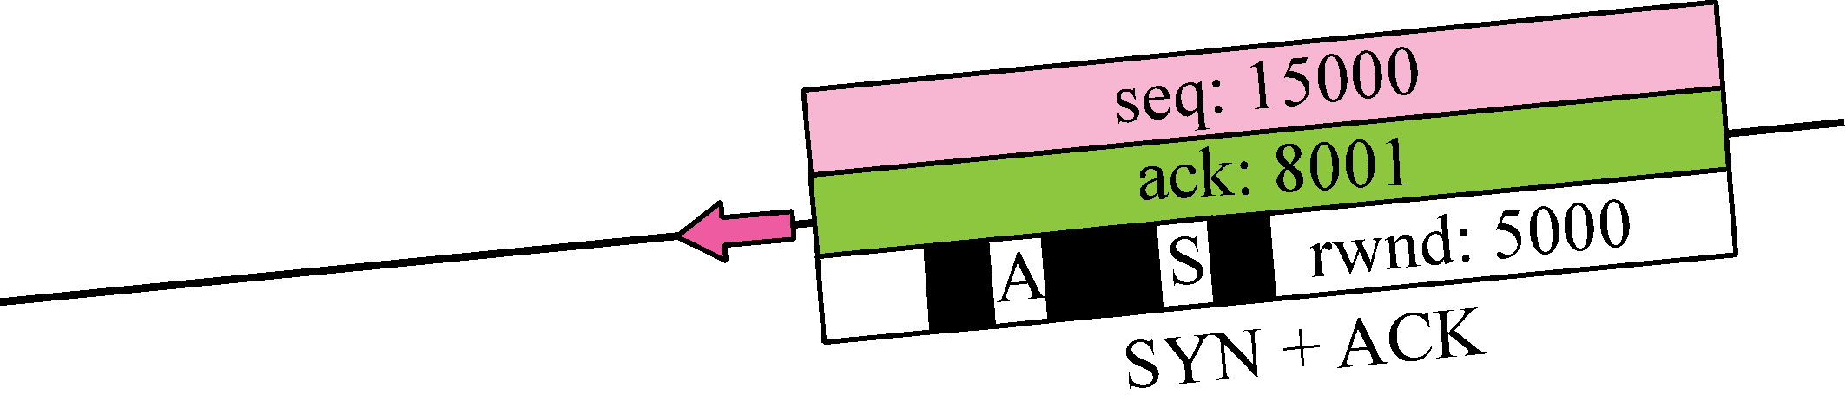
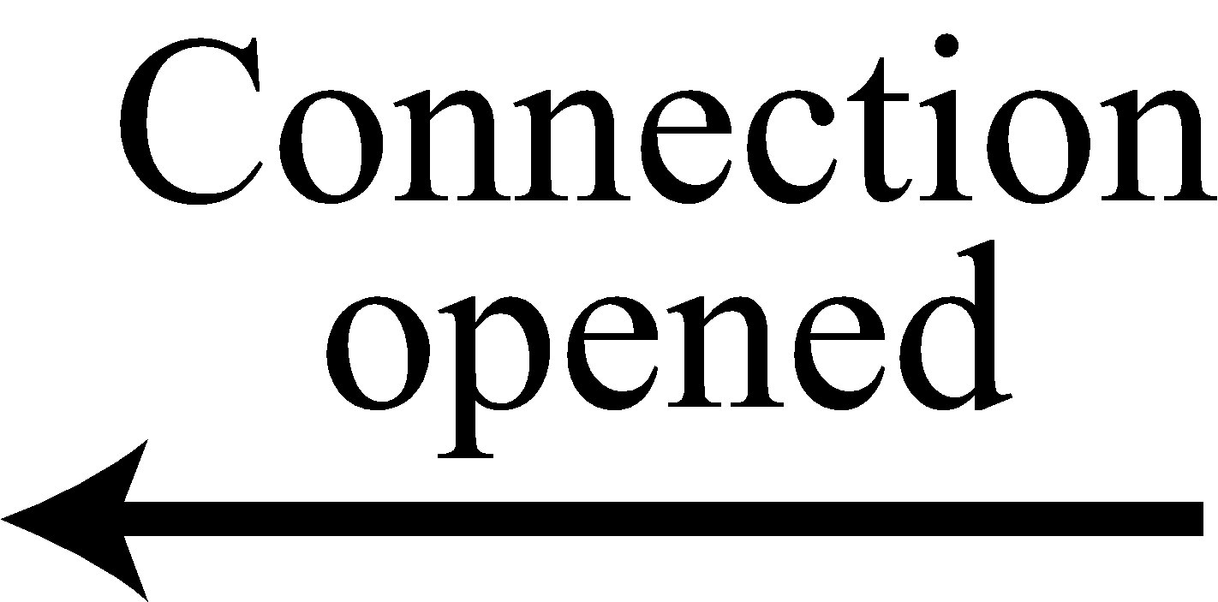
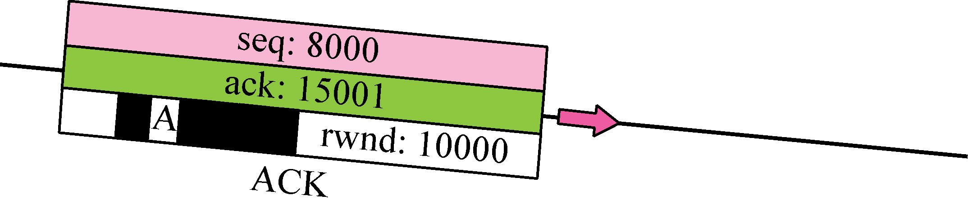

Figure 15.9 Connection establishment using three-way handshake
Means “no data” !
seq: 8001 if piggybacking
TCP/IP Protocol Suite
‹#›
Notes:
‹#›

Slide 34
Note
A SYN segment cannot carry data, but it consumes one sequence number.
TCP/IP Protocol Suite
‹#›
Notes:
‹#›

Slide 35
Note
A SYN + ACK segment cannot carry data, but does consume one sequence number.
TCP/IP Protocol Suite
‹#›
Notes:
‹#›

Slide 36
Note
An ACK segment, if carrying no data, consumes no sequence number.
TCP/IP Protocol Suite
‹#›
Notes:
‹#›

Slide 37
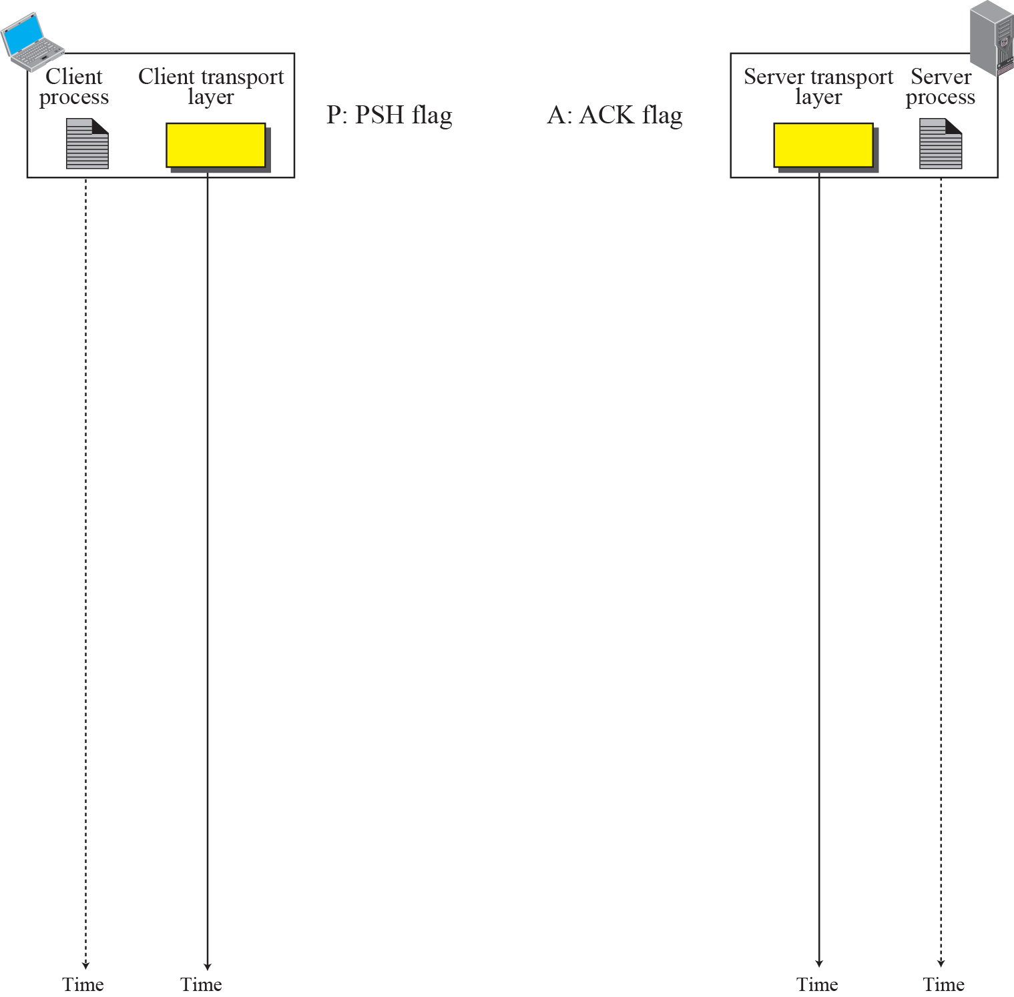
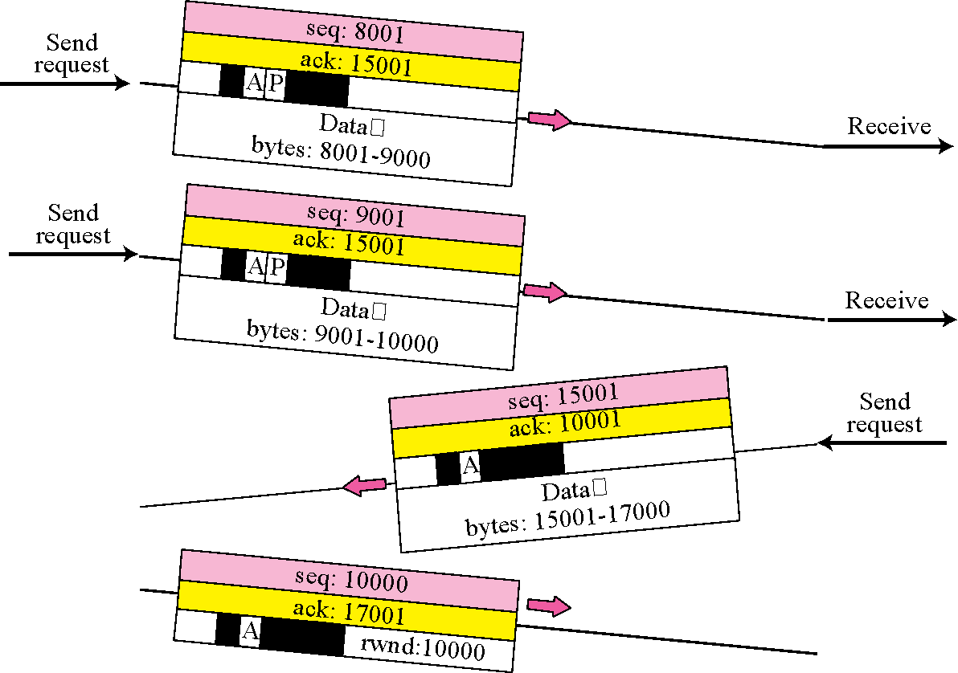

Figure 15.10 Data Transfer
Pushing data
Urgent data
TCP/IP Protocol Suite
‹#›
Notes:
‹#›

Slide 38
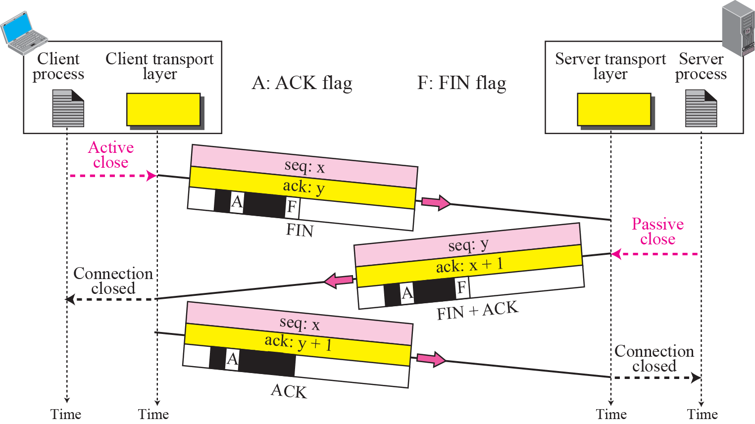
Figure 15.11 Connection termination using three-way handshake
TCP/IP Protocol Suite
‹#›
Notes:
‹#›

Slide 39
Note
The FIN segment consumes one sequence number if it does not carry data.
TCP/IP Protocol Suite
‹#›
Notes:
‹#›

Slide 40
Note
The FIN + ACK segment consumes one sequence number if it does not carry data.
TCP/IP Protocol Suite
‹#›
Notes:
‹#›

